Slide 1
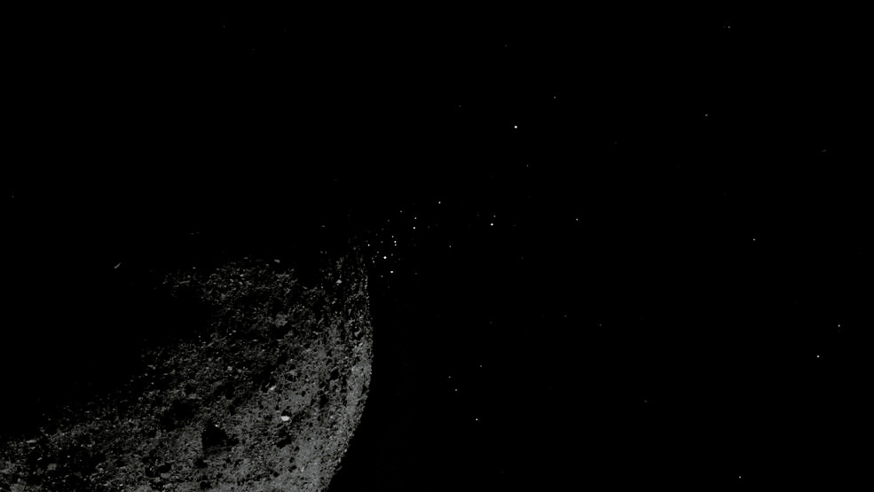

Is there fine-grained material under the surface of Bennu?
Claire Gibson, Joshua Emery
Credits: NASA/Goddard/University of Arizona/Lockheed Martin

Slide 2
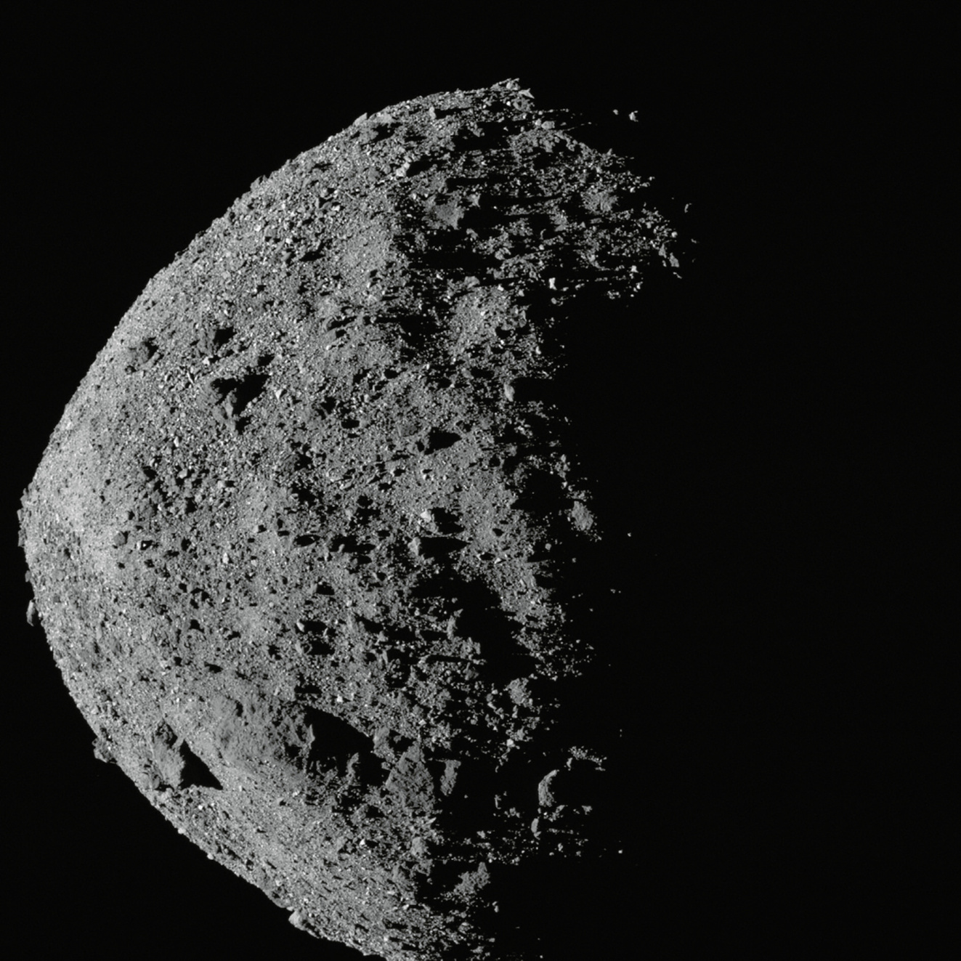
Agenda
Background
1
  Method
  2
  Results
  3
  4
  What comes next?
Credits: NASA/GODDARD/UNIVERSITY OF ARIZONA

Slide 3
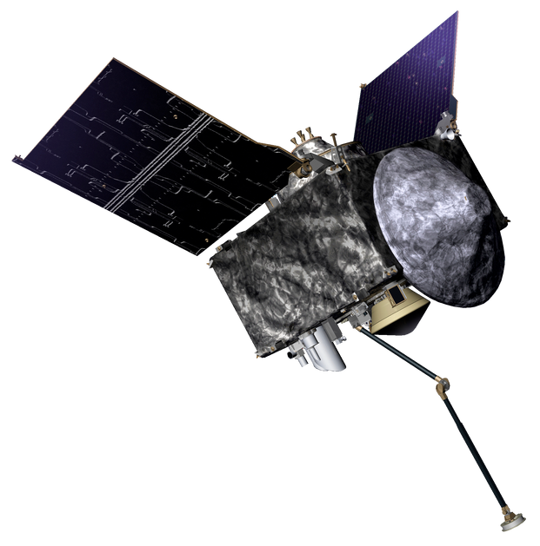
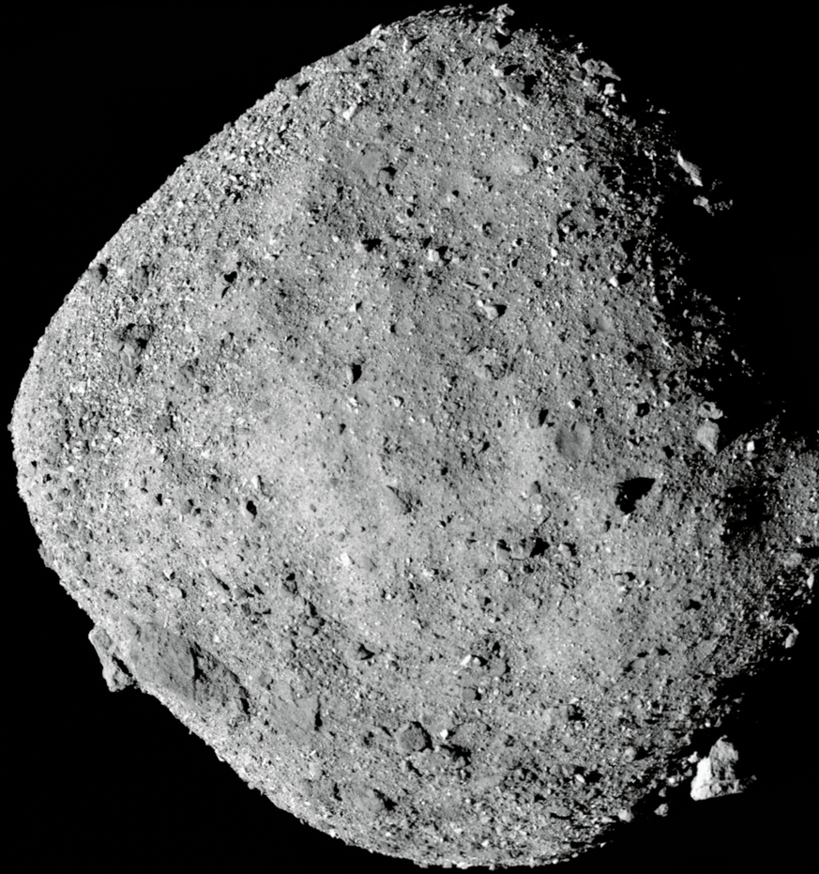
101955 Bennu
Question: Does fine grained ( <100µm) material exist beneath the surface of "rubble pile" asteroid Bennu?
Our opproach to answer this question is to use thermal inertia data from the OSIRIS-REx spacecraft.
Credits: NASA/Goddard/University of Arizona

Slide 4
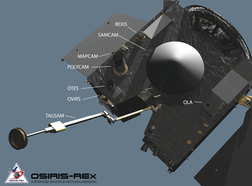
OSIRIS-REx Spacecraft
OSIRIS-REx Thermal Emission Spectrometer (OTES) was used in this research
Why thermal inertia?
Thermal inertia (TI) is the resistance to change in temperature. TI can indicate what kind of material there is on a surface.

Slide 5
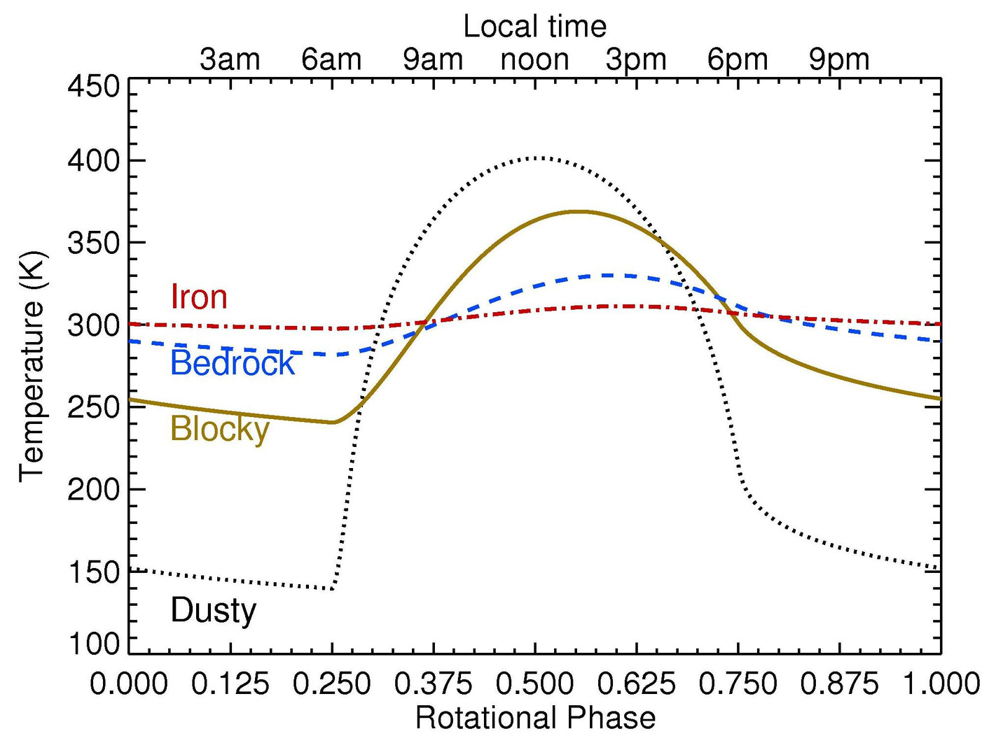
Distinguishing Materials by measuring temperature over time.
Image Credit: Joshua Emery

Slide 6
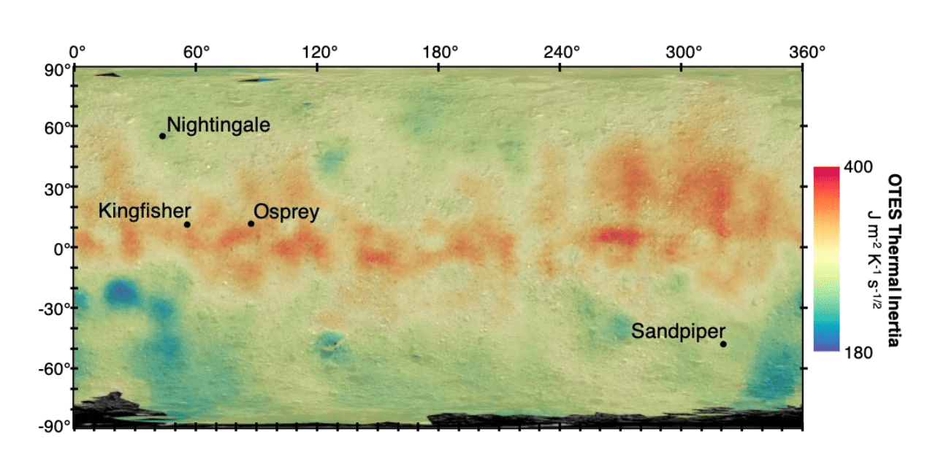
Image Credit: Rozitis et. all 2020
Notes:
Image of Global thermal inertia here?

Slide 7
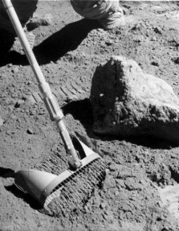
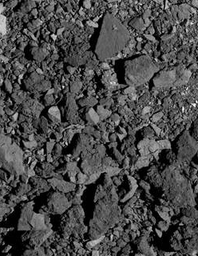
Moon
Bennu
Fine grained material on planetary bodies: where can it be found?
Courtesy of NASA, AS16-116-18690.
Credits: NASA/Goddard/University of Arizona
Notes:
add scale bar to bennu pic

Slide 8

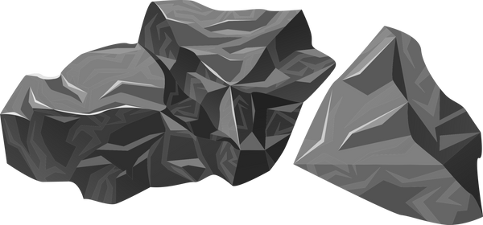


Surface of Bennu
Crater
Why craters?
  Craters can allow us to "look" below the surface of a planetary body.
Subsurface
Fine-grained material?

Slide 9
Methods
Using crater sites
Looking for low thermal inertia
Creating a shape model for a crater site.
Thermal modeling of the crater site
Craters may be able to unearth what is below the surface of Bennu.
Fine grained material should have a low thermal inertia.
Each crater site analyzed has a shape model as a basis for thermal modeling.
Detailed analysis of thermal inertia in the crater region allows us to determine whether fine grained exists. material
Notes:
add cartoon of crater depth/ why we want that here.

Slide 10
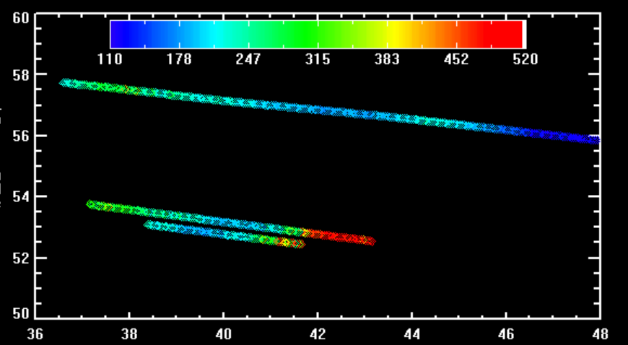
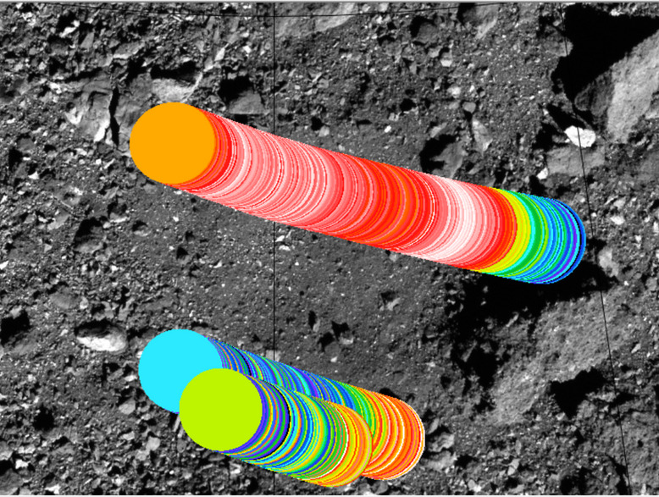
Thermal Inertia of Nightingale Site J m s K
-1/2
-2
-1
Add a little bit of body text
Latitude
Longitude
Nightingale Comparison
Notes:
color on the swaths

Slide 11
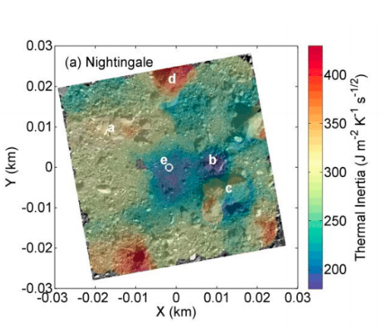
Thermal Inertia of Nightingale site
Latitude
Longitude
Results: strong indication of fine grained material at this location: agrees with previous observation
Image Credit: Rozitis et all. 2022 (submitted)
Notes:
Draw lines on the right image

Slide 12
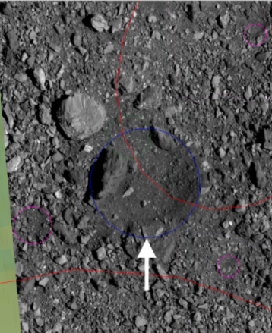
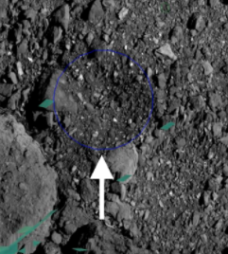
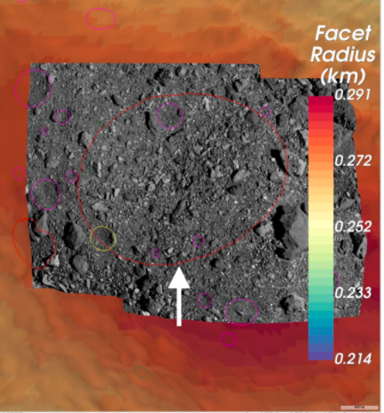
What Comes Next
Analyzing more craters to see if fine grained material exists within a certain depth/elsewhere on Bennu
12.0 m Crater
15.2 m Crater
43.1 m Crater
Credit: Beau Bierhaus
Credit: Beau Bierhaus
Credit: Beau Bierhaus

Slide 13

Claire Gibson
Thank you!
cag652@nau.edu
NAU NASA Space Grant Intern
Department of Astronomy and Planetary Science
https://tlw389.wixsite.com/nau-emerge

